Slide 1
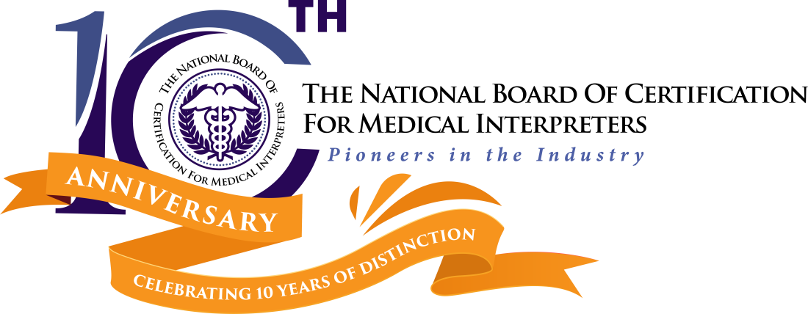

Available CMI credentials:
Spanish
Russian
Korean
Mandarin
Cantonese
Vietnamese

Slide 2

Who are we?
The National Board is a non-profit certifying body that is also an independent division of the International Medical Interpreter Association (IMIA).
Our mission is to foster improved healthcare outcomes, patient safety, and patient/provider communication by elevating the standards for and the quality of medical interpreting through a nationally recognized and validated certification for medical interpreters.

Slide 3
Certification vs Certificate
Certification:
A structured testing process through which an accredited entity grants a time-limited credential to an individual after verifying that he/she has met predetermined and standardized criteria. Once you have successfully completed the certification process you can call yourself a Certified Medical Interpreter (CMI).
Certificate of Completion:
Completed a course of study or training in interpreting, and received a certificate of completion. You CANNOT call yourself a Certified Medical Interpreter by just completing the training.

Slide 4
Certification Timeline
REGISTER ONLINE submit documents
DOCUMENTATION REVIEW
2 weeks
SCHEDULE AND TAKE
WRITTEN EXAM
Receive score immediately
SCHEDULE
Oral Exam
Within 6 months
Available year round
TAKE ORAL EXAM
Find out score in 8-10 weeks

Slide 5
Pre-requisites
Age: at least 18 years old
General education: Minimum High School Diploma or equivalent
Medical interpreter education: A minimum of a 40 hour program (certificate of completion is the only proof of education accepted)
Oral proficiency in English
Oral proficiency in target language

Slide 6
Certification Process
Step 1: Register online and submit prerequisites ($35)
Step 2: Take Written Exam – In English ($175)
Step 3: Take Oral Exam – In English and target language ($275)
There is a three (3) month waiting period to retake the exams, same fees apply
NOTE: All fees are payable to the National Board and go towards processing registration, administering the exams, or further development of new test versions.

Slide 7

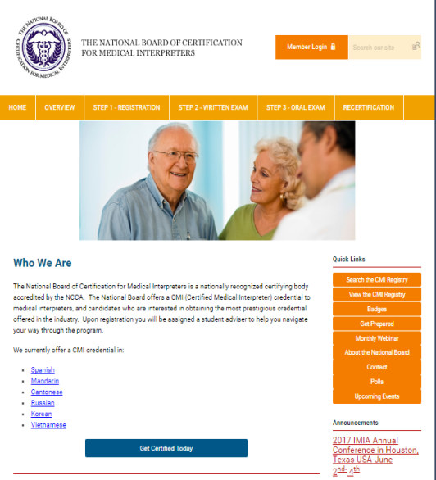
Certification Process
Step 1: Register (online)
Create user profile (use the same name as in your government-issued ID)
Pay a registration fee of $35
Upload prerequisites/documents including picture
NB adviser assigned

Slide 8
Certification Process (cont…)
Step 2: Take Written Exam
Within 2 weeks you will receive a Letter of Approval stating that you may now schedule your written test
You must inform your adviser if you want to schedule the written exam at a PSI testing site or through the online Proctor U process
Depending on the method you choose, you will be contacted by either Proctor U or PSI with instructions within a week

Slide 9
Step 3 – Oral Exam
Certification Process (cont…)
Once you have successfully passed the Written Exam you will have up to six (6) months to schedule your Oral Exam
Contact your adviser and she will send you a link for the payment
Then email your adviser with 3 possible dates for the test
She will email you the information for the testing
Happy testing and good luck!
You are on your way!

Slide 10
Written Exam Topics
Exam is in English
Medical Knowledge and Medical Specialties | 61%
Medical Interpreter Code of Ethics | 15%
Roles of the Medical Interpreter | 8%
Cultural Awareness | 8%
Interpreter Standards of Practice (IMIA, CHIA, NCIHC) | 5%
Legislation and Regulations (HIPAA, CLAS, Title VI of 1964) | 3%

Slide 11
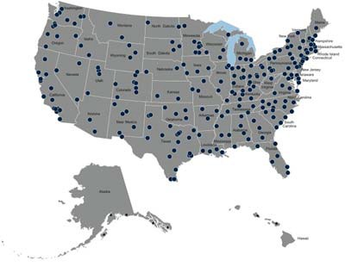
Taking the written exam:
Testing sites:
  200+ PSI sites across the U.S. and Canada using web technology
  Scheduled on demand at a mutually agreed upon time
PSI locations: www.psionline.com
Proctor U: Test from home, or wherever you are!
  Scheduled on demand at a mutually agreed upon time www.proctoru.com
  Must use PC (not Mac)
6

Slide 12
Taking the written exam:
Format
  60 multiple choice questions
  75 minutes
Taking the exam:
  Computer-based
  Change your answer as many times as you want
  Get your results as soon as you are done

Slide 13
Written Exam Preparation
Recommendations:
Review medical terminology and medical concepts
Review the Standards of Practice and Code of Ethics from the:
  International Medical Interpreters Association www.imiaweb.org
  California Healthcare Interpreter Association www.chiaonline.org
  National Council on Interpreting in Health Care www.ncihc.org
Review Title VI of the Civil Rights Act of 1964, the Health Information Privacy (HIPAA)
  www.hhs.gov/ocr
Review the CLAS Standards:
  http://minorityhealth.hhs.gov/
  www.lep.gov

Slide 14
Code of Ethics and
Professionalism
Confidentiality
Accuracy
Impartiality
Advocacy
Respect
Cultural Awareness
Role Boundaries (scope of practice, conflict of interest)
Professionalism (disqualification/Impediments to performance)
Professional Development

Slide 15
Sample question on the written test
If a patient has renal failure, this means that he/she has a disease primarily related to:
The pancreas
The kidneys
The liver
The spleen

Slide 16
Oral exam – skills tested
Exam in different languages
Mastery of linguistic knowledge in English and the other language | 30%
Consecutive interpreting and sight translation skills (from English into target language) | 25%
Knowledge of medical terminology and specialties – within context in both languages | 35%
Cultural awareness | 10%
Languages available:
Spanish, Mandarin, Cantonese
Russian, Korean, Vietnamese

Slide 17
Medical Terminology
Medical Tests and Diagnostics
Medical Apparatus
Pharmacology
Pathologies
Symptomatology
Anatomy
Musculoskeletal System
Endocrine
Respiratory
Cardiovascular
Urinary
Nervous
Digestive
Reproductive
Integumentary (skin)
Treatments
Acronyms and
Abbreviations

Slide 18
Medical Specialties
Orthopedics
Radiology
Nutrition Counseling
Endocrinology
Ophthalmology
Neurology
Psychiatry
Ob/Gyn & Genetic Counseling
ENT
Pediatrics
Emergency medicine
Oncology
Surgery

Slide 19

Taking the oral exam:
Testing site or at home using ProctorU.
  Sites around the country and Canada
  Length of time: 45 minutes to an hour
    2 sight translations - 10 minutes
  12 mini-scenarios - 30 minutes
  Unlimited time to read the directions and listen to the examples
Taking the exam:
  On a PC computer, with headset and mic
  Starts with a system check & set up
  Segments are timed
Materials allowed:
  Pencil/Pen and paper for note taking
  One dictionary (nothing electronic allowed)

Slide 20
Oral Exam
EXPECTATIONS:
Interpret accurately and clearly, reflecting the speaker’s tone
Maintain the register and style of the speaker
Use appropriate grammar and syntax
Deliver the renditions at an even pace of delivery and with a professional demeanor
Adhere to the correct interpreting protocol for the medical field, which is first person interpreting, or direct speech
Interpret without summarizing or paraphrasing, or adding or omitting any information provided

Slide 21
Sample sight translation
Cast Care instructions:
Elevate your extremity above your heart as much as possible.
Never submerge the cast in water.
Take your prescribed medicine every 4-6 hours, as needed, for pain.
Take an over-the-counter medication for itching.
Call your doctor immediately if the pain gets worse or you see redness around the affected area.

Slide 22
Sample oral exam scenario to interpret consecutively:
What brings you to the emergency room today?
I feel a sharp pain in my chest, dizziness and tingling in my arms and legs (in other language).
Please tell me about your symptoms and when they started.
The pain woke me up this morning at 2 a.m. but yesterday evening I was nauseated and felt pain in the pit of my stomach. (in other language).
Is the pain constant or does it come and go? Does it radiate to your arms or legs?
It’s a tight pain in the center of my chest, and my neck is sore. (in other language).
I will examine you and also order an EKG and some blood tests.

Slide 23
Instructional Video:
It is very important that you review an instructional video (available on our website) http://www.screencast.com/t/YcJAsmjL2J
This video walks you through the steps on how to navigate the oral exam including how and when to record your renditions and request your six (6) repetitions. If you fail to correctly navigate through the oral exam your score will be negatively impacted.
We recommend that you view this video at least 3 times to truly become familiarized with the navigation of the test.

Slide 24
Passing Scores:
Written Exam (English) – 75%
Oral Exam (Target Language):
- Spanish, Russian, Korean, Cantonese - 70%
- Mandarin - 80%
- Vietnamese – 65%

Slide 25
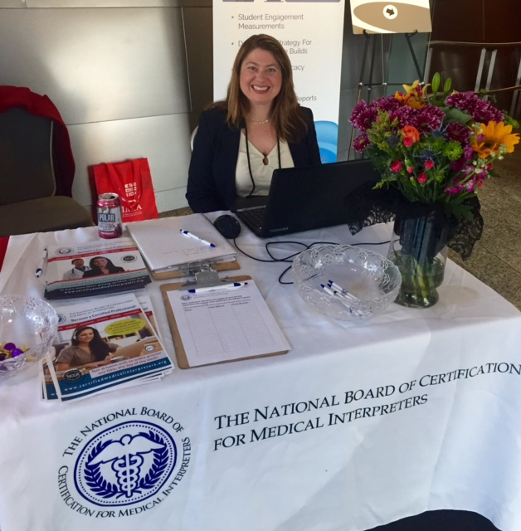
Get certified!
You will:
Ensure patient safety and quality of care
Align yourself to the highly credentialed healthcare profession, and distinguish yourself from your peers
Lead by example; help promote certification as an industry standard

Slide 26
Ten Great Reasons
1. Valid National Credential – Our certification exams are validated by a third-party organization (PSI), delivering psychometric quality, statistical analysis and professionally sound test form assembly. The CMI certification continues to be a very VALID and highly recognized credential for its standards and excellence.
2. Rigorous/High Standards –The NBCMI verifies that each candidate meets ALL the prerequisites prior to testing. Delivers high quality and rigorous written and oral exams
3. Testing:
- Exams can be scheduled YEAR ROUND at a mutually agreed upon time at one of our many testing centers.
- We offer the convenience of testing from home through its Proctor U online proctoring, using a cutting-edge methodology for certification programs.

Slide 27
Ten Great Reasons
4. FULL Certification in More Languages – The National Board offers FULL certification in six (6) languages: Spanish, Mandarin, Cantonese, Russian, Vietnamese and Korean. What this means is that all of our six languages are fully tested in written and oral, not only in English, but also in the interpreter’s target language. This meets the definition of a qualified interpreter by the Joint Commission, as well as by the Affordable Care Act Section 1557.
5. Five-Year Recertification – Our certification is valid for five years making it more cost effective.
6. Credential Maintenance – Requires 30 hours of continuing education units, which can be done within the five-year span. Continuing education MUST focus on medical interpreting and medical knowledge courses, maintaining the high standards for the credential.

Slide 28
Ten Great Reasons
7. Online Registry - The NBCMI registry is public. Prospective employers can search our registry and contact our interpreters directly by email. What a great way to boost your visibility and improve job opportunities. It also allows prospective employers to verify credentials.
8. International Recognition - The CMI credential is internationally recognized.
9. Pioneers in the Industry – The National Board was founded in 2009 and was the FIRST to offer certification for medical interpreters nationwide, setting the testing standards.
10. IMIA – The National Board is proud to be an independent division of the International Medical Interpreters Association (IMIA). The IMIA was founded in 1986 and in 1987 published the first Code of Ethics for medical interpreters.

Slide 29
What happens after certification?
In order to maintain your credential you must renew every 5 years
The cost to recertify is $300
You will need to submit 30 hours of continuing education before your credential expires
Continuing education is essential for continued growth and development of the profession.

Slide 30

Get involved!
Please visit: www.certifiedmedicalinterpreters.org
Send an email to: staff@certifiedmedicalinterpreters.org
http://www.facebook.com/pages/CertifiedMedicalInterpreters

